Slide 1
Intergame 2014, Tallinn
Tomi Paananen
Specialist

Slide 2
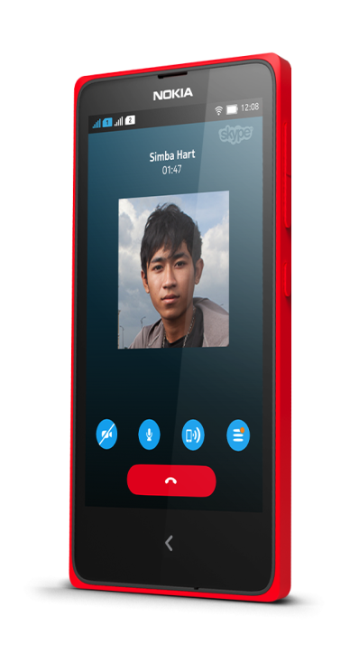
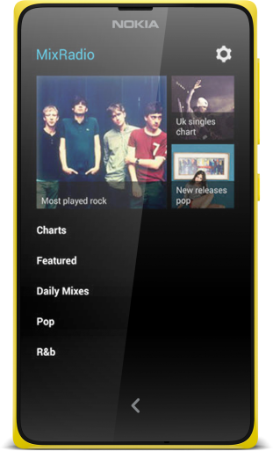
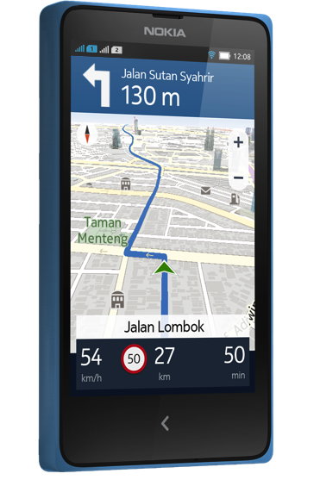
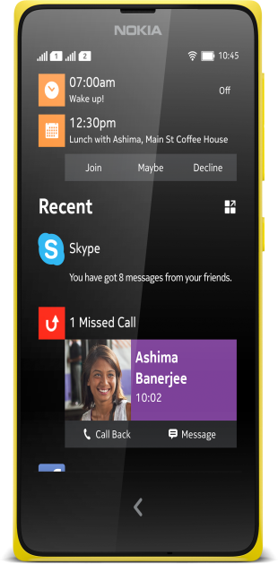
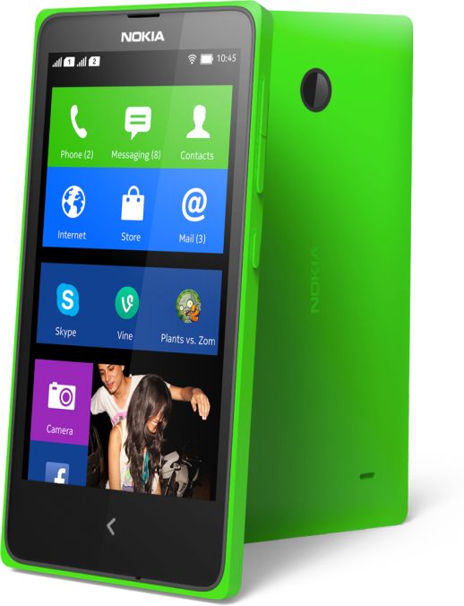
Nokia X from low-end to the future
Nokia X
Access to the world of
Android apps
Nokia X
Smoother,
faster flow between your favorite
apps
Nokia X
Standout
design that’s built to last
+
+

Slide 3
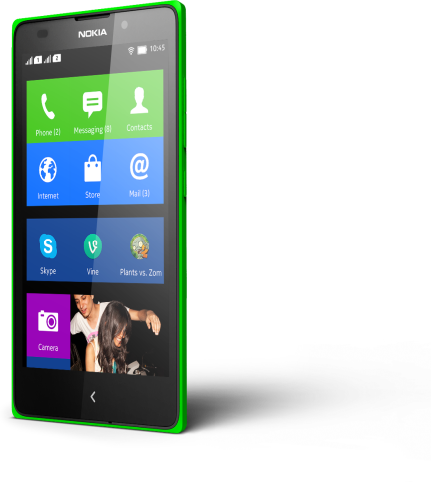
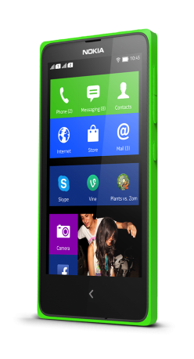
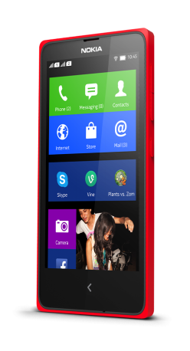
Nokia X Technical Specifications
Nokia X
Nokia X+
Nokia XL
4” screen (800*480)
1GHz Dual core CPU
3MP camera
7.2Mbps 3G
100 Mbps Wi-Fi
Fastlane UI
4GB internal memory,
512MB RAM, 32GB Micro SD slot
API level 16 (Android version 4.1.2)
4” screen (800*480)
1GHz Dual core CPU
3MP camera
7.2Mbps 3G
100 Mbps Wi-Fi
Fastlane UI
4GB internal memory, 768MB RAM, 32GB Micro SD slot
API level 16 (Android version 4.1.2)
5” screen (800*480)
1GHz Dual core CPU
5MP AF camera
1MP front facing camera
7.2Mbps 3G
100 Mbps Wi-Fi
Fastlane UI
4GB/768MB/32GB Micro SD Slot
API level 16 (Android version 4.1.2)
Notes:
CPU: Qualcomm MSM8225 1 GHz dual core
GPU: Adreno 203

Slide 4
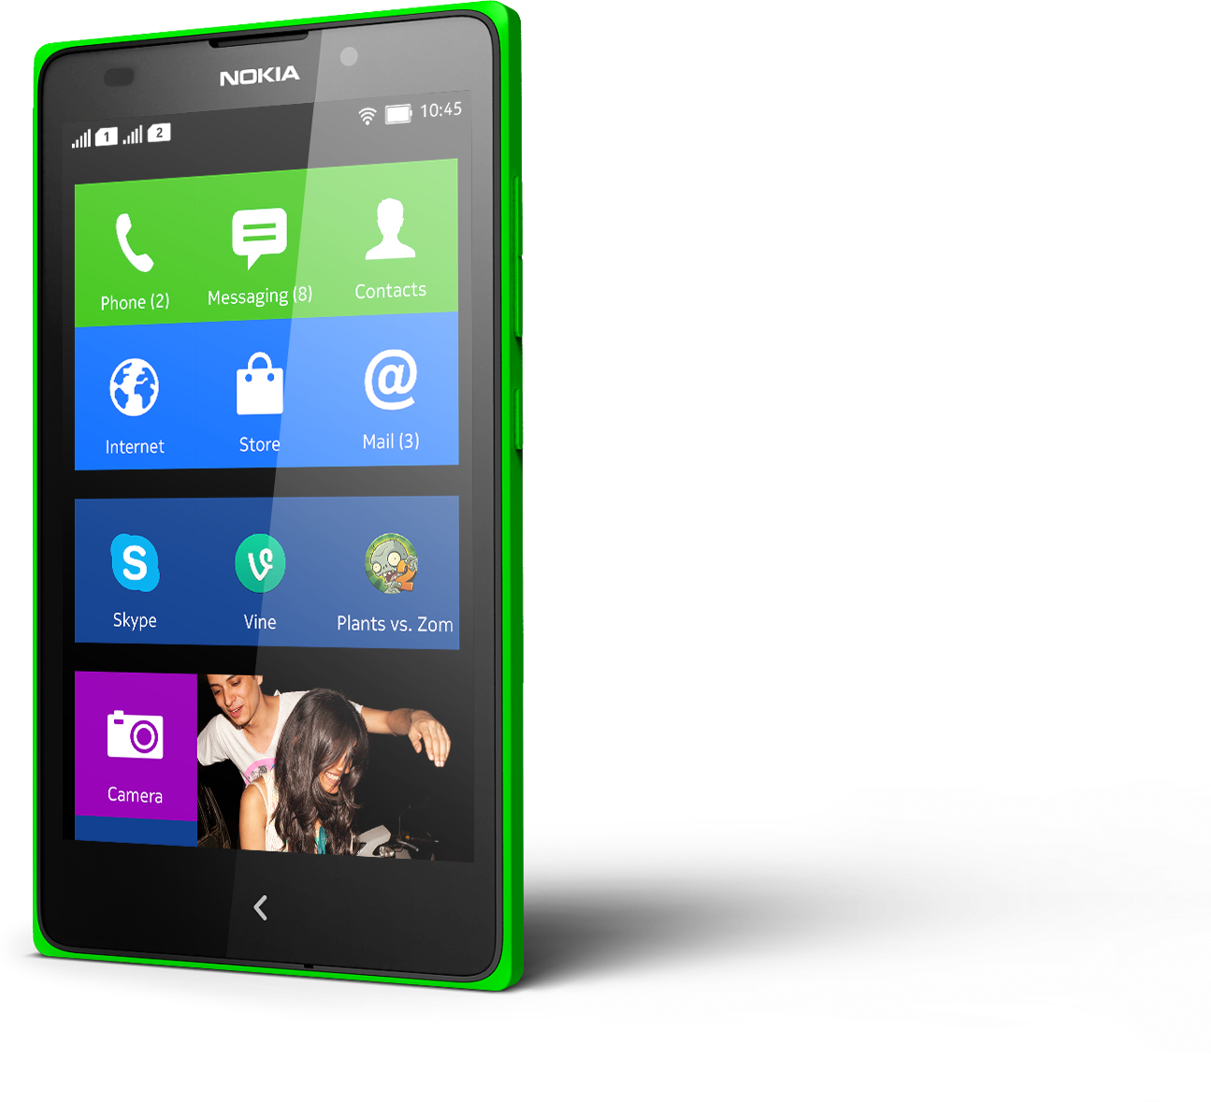
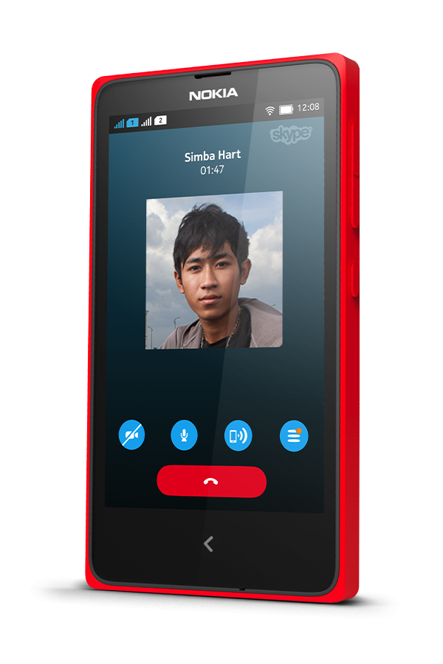
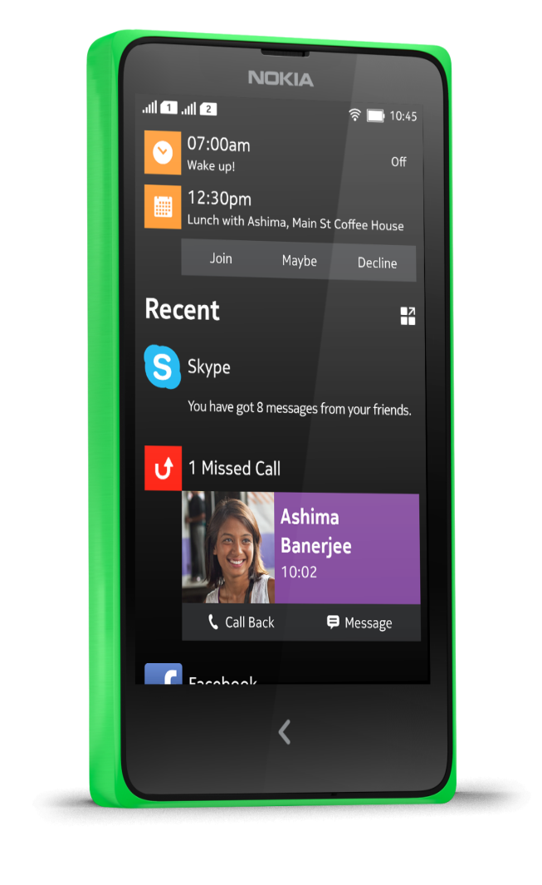
What does Nokia X offer to developers?

Slide 5
Nokia X Developer Opportunity
102B
$26B
90%
app downloads
in-app payment revenue
of apps are free
It is all about Freemium and IAP now...
Source: Gartner

Slide 6
Nokia X Developer Opportunity
3/5
0/10
OF TOP ANDROID DOWNLOAD* COUNTRIES WERE GROWTH MARKETS (INDIA, RUSSIA, BRAZIL).
OF THE GROWTH MARKETS MADE IT TO THE TOP 10 REVENUE COUNTRIES
Source: App Annie
* download data from Google Play

Slide 7
Nokia X Developer Opportunity
 | US | KOREA | VIETNAM | INDIA | INDONESIA
POPULATION | 317M | 50M | 89M | 1200M | 237M
CREDIT CARDS | 686M | 96M | 2M | 24M | 10M
The lack of credit cards excludes huge audience

Slide 8
Nokia X In-App Payment broadest reach
Live Operators
  ■Full Country coverage
  ■Partial Country coverage
  ■No Country coverage
60 Markets* / 160+ Operators!
*) China has a different publishing and in-app payment policy compared to other markets

Slide 9
Software platform

Slide 10



Nokia X software platform
A new platform built with Android Open Source Project (AOSP) at its core. It combines a popular smartphone software base with Microsoft’s global reach and strength creating new opportunities for your apps.
Android 3rd party
applications
Nokia In-App Payment
API
HERE
API
Nokia Notifications
API
Nokia X
software platform 1.0
Nokia
UX
Nokia
Store
Android Open Source Project 4.1.2 (API level 16)

Slide 11
Nokia X What is it all about
Nokia X = Android – Google Services + Nokia X Services
AOSP 4.1.2
API level 16
Google Play Services
Google Maps
Google Cloud Messaging
Google+
Nokia In-App Payment
HERE Maps
Nokia Notifications

Slide 12



Nokia X APIs
HERE Maps
Nokia Notifications
Nokia In-App Payment
HERE maps provides complete offline experiences like no other maps service.
Simple yet powerful notifications service.
World’s largest operator billing network.

Slide 13

Nokia X 100 000+ Android applications tested
75% Android applications work unmodified
25% require
small changes
Application ready to publish in Nokia Store.
No porting, no coding just publish!
Nokia X service APIs
Nokia In-App Payment
HERE Maps
Nokia Notifications
(replace Google APIs)

Slide 14



Nokia X Compatibility – it’s a no brainer
Nokia testing has shown that about 75% of Android apps will run properly without any modifications.
Plus we give you easy to use online and offline tools to check your applications within seconds.
Nokia X analyser developer.nokia.com
75% work
unmodified
25% need
a little retouch
Submit .apk to
Nokia Store
Port using
Nokia X
Services SDK
Up to
8h porting*
*For most apps, depending on application complexity and number of used APIs that need porting

Slide 15
Games on Nokia X

Slide 16






Nokia X Game frameworks
If it works on AOSP, it will work on Nokia X
OpenIAB plug-in for Unity with Nokia In-App Payment integration already available!
Implementing Nokia X API support to plug-ins is easy
…and more…

Slide 17
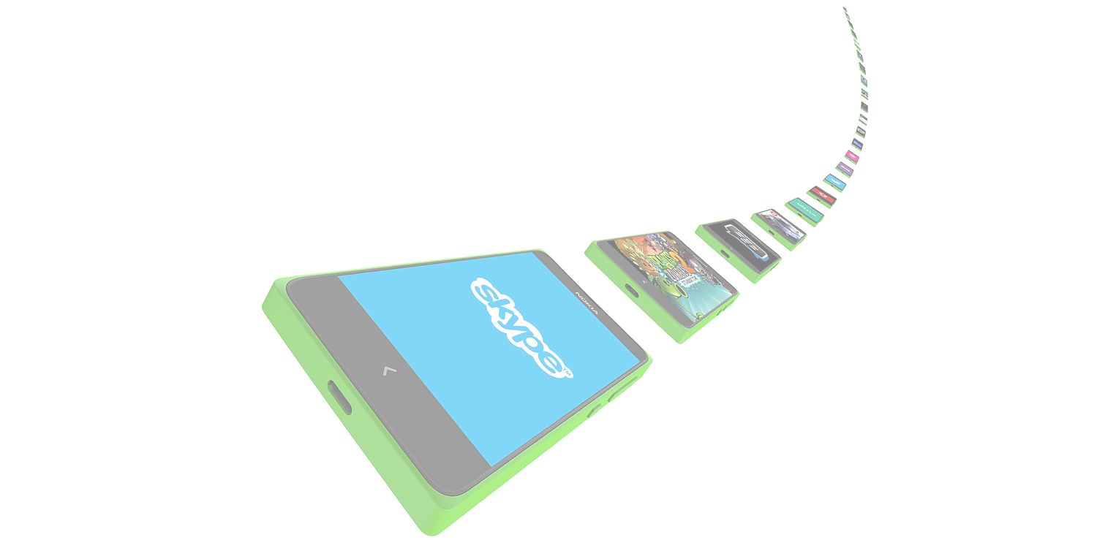




Nokia X Game services
…and many more…
Notes:
Generally for leaderboards/highscores, social sharing, realtime gaming experiences
Nuggeta: A cloud service designed to power real-time, social and collaborative games
Scoreloop: Social gaming network
Amazon GameCircle: Leaderboard, save data to cloud
Photon: Realtime multiplayer games

Slide 18
Nokia X Ads
Use of 3rd party ad frameworks perfectly OK
Google AdMob works
Does the framework provide relevant content?
Notes:
Vserv
MoPub
adcash

Slide 19
Nokia X Summary
Nokia X is Microsoft’s new platform with Android at its core
Nokia X porting is easy and fast
Nokia X opens new markets to your existing games

Slide 20
Nokia X
Thanks for your time
tomi.paananen@microsoft.com - @tompaana
developer.nokia.com/nokia-x
dvlup.com

