Slide 1


Winning the War for Software Engineering Talent
Dobroslav Dimitrov
Co-founder, Game Designer
InterGame 2014 in Tallinn

Slide 2
# What are we going to talk about
About me
About Imperia Online
Why war?
What does the cross platform hell looks like?
Solutions
The Imperia Way
QA
Dobroslav Dimitrov, InterGame 2014
Winning the War for Software Engineering Talent?

Slide 3
# About me
Graduated Finances in USA
Serial entrepreneur - 14 years of experience in different fields
Co-founder of Imperia Online Ltd.
A leading game designer for over 9 years
An interesting fact: elected member of the Bulgarian parliament 2009-2014
Dobroslav Dimitrov, InterGame 2014
Winning the War for Software Engineering Talent?

Slide 4
# About Imperia Online
Founded in 2005
First investment - $1000
No external funding
25+ million registrations
Localized in over 26 languages
4 web-based games
Dobroslav Dimitrov, InterGame 2014
Winning the War for Software Engineering Talent?

Slide 5
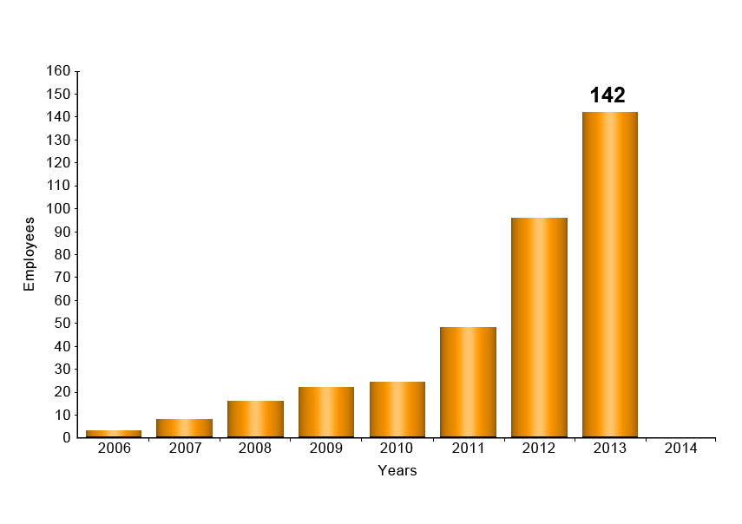
# About Imperia Online
Dobroslav Dimitrov, InterGame 2014
Winning the War for Software Engineering Talent?

Slide 6
# Why War?
Developers, developers, developers :)
Ever harder to find
Ever more platforms requiring more of them
Ever more companies wanting to do the same
= the most competitive industry today… on global scale
Dobroslav Dimitrov, InterGame 2014
Winning the War for Software Engineering Talent?

Slide 7
# Why War?
However...
Dobroslav Dimitrov, InterGame 2014
Winning the War for Software Engineering Talent?

Slide 8
# Why War?
The greatest victory is that which requires no battle…
Sun Tzu
Dobroslav Dimitrov, InterGame 2014
Winning the War for Software Engineering Talent?

Slide 9
# Cross-platform hell
Description
Task - behemoth project - 1000+ game screens
Dobroslav Dimitrov, InterGame 2014
Winning the War for Software Engineering Talent?

Slide 10
# Cross-platform hell
Description
Task - behemoth project - 1000+ game screens
Manpower - daunting - native app requires many separate teams repeatedly doing 1000+ screens
Dobroslav Dimitrov, InterGame 2014
Winning the War for Software Engineering Talent?

Slide 11
# Cross-platform hell
Description
Task - behemoth project - 1000+ game screens
Manpower - daunting - native app requires many separate teams repeatedly doing 1000+ screens
Skill - different platforms, mean different skills… some like iOS are all too new to have a pool of ready specialists…
Dobroslav Dimitrov, InterGame 2014
Winning the War for Software Engineering Talent?

Slide 12
# Cross-platform hell
Description
Task - behemoth project - 1000+ game screens
Manpower - daunting - native app requires many separate teams repeatedly doing 1000+ screens
Skill - different platforms, mean different skills… some like iOS are all too new to have a pool of ready specialists…
Time - ever changing product, always a catch up game
Dobroslav Dimitrov, InterGame 2014
Winning the War for Software Engineering Talent?

Slide 13
# Cross-platform hell
Interlocked problems
Task - 1000+ screens = boring work
Dobroslav Dimitrov, InterGame 2014
Winning the War for Software Engineering Talent?

Slide 14
# Cross-platform hell
Interlocked problems
Task - 1000+ screens = boring work
Manpower - boring and repetitive work = experienced people don’t want to do it
Dobroslav Dimitrov, InterGame 2014
Winning the War for Software Engineering Talent?

Slide 15
# Cross-platform hell
Interlocked problems
Task - 1000+ screens = boring work
Manpower - boring and repetitive work = experienced people don’t want to do it
Skill - few specialists = a great choice of companies for them to do interesting things
Dobroslav Dimitrov, InterGame 2014
Winning the War for Software Engineering Talent?

Slide 16
# Cross-platform hell
Interlocked problems
Task - 1000+ screens = boring work
Manpower - boring and repetitive work = experienced people don’t want to do it
Skill - few specialists = a great choice of companies for them to do interesting things
Time - ever more screens to make = the “post office problem” - the work never ends
Dobroslav Dimitrov, InterGame 2014
Winning the War for Software Engineering Talent?

Slide 17
# Cross-platform hell
Interlocked problems
Task - 1000+ screens = boring work
Manpower - boring and repetitive work = experienced people don’t want to do it
Skill - few specialists = a great choice of companies for them to do interesting things
Time - ever more screens to make = the “post office problem” - the work never ends
= problems with motivation
Dobroslav Dimitrov, InterGame 2014
Winning the War for Software Engineering Talent?

Slide 18
# Cross-platform hell
Solution
Task - teams of 1 experienced developer and 3-4 juniors
The senior dev plans and oversees the work, while taking care of difficult tasks
The juniors take care of the repetitive and massive task of hundreds of screens
In the process the juniors are becoming extremely familiar with the product
Dobroslav Dimitrov, InterGame 2014
Winning the War for Software Engineering Talent?

Slide 19
# Cross-platform hell
Solution
Manpower - clever division of labor in order to half the time of development
One team is working on iOS/Android, one on PhoneGap, starting from opposite directions
After launch works continues until full native support is achieved
At the end you have full mobile support for all major platforms
Dobroslav Dimitrov, InterGame 2014
Winning the War for Software Engineering Talent?

Slide 20
# Cross-platform hell
Solution
Skill - where you don’t have it - create it
Experienced developers migrate easily to new technologies
Sometimes it’s better to start from 0
Time - with permanent teams, catching up is no longer an issue
Dobroslav Dimitrov, InterGame 2014
Winning the War for Software Engineering Talent?

Slide 21
# The Imperia Way
Asking the right questions
Do we need only experienced people?
Where do we find juniors with the right skill?
How hard can it be to create a developer?
How long would that take?
Would people be interested?
Is it economically feasible?
Do we dare try?
Dobroslav Dimitrov, InterGame 2014
Winning the War for Software Engineering Talent?

Slide 22
# The Imperia Way
Asking the right questions
Do we need only experienced people? No.
Where do we find juniors with the right skill? Create them.
How hard can it be to create a developer? Doable.
How long would that take? 5 months.
Would people be interested? Ooooh yeahhh!
Is it economically feasible? Yes.
Do we dare try? What do you think? :)
Dobroslav Dimitrov, InterGame 2014
Winning the War for Software Engineering Talent?

Slide 23
# The Imperia Way
The Imperial Training Camp
Dobroslav Dimitrov, InterGame 2014
Winning the War for Software Engineering Talent?

Slide 24
# The Imperia Way
The Imperial Training Camp
First season - May-September 2013:
600 applicants, 100 interviews, 40 final draft students, 20 hired, 20 still work for us
Dobroslav Dimitrov, InterGame 2014
Winning the War for Software Engineering Talent?

Slide 25
# The Imperia Way
The Imperial Training Camp
First season - May-September 2013:
600 applicants, 100 interviews, 40 final draft students, 20 hired, 20 still work for us
Second season - November-May 2014:
1400 applicants, 200 interviews, 80 final draft, 60 finished the course… interviews for hiring are in progress
Dobroslav Dimitrov, InterGame 2014
Winning the War for Software Engineering Talent?

Slide 26
# The Imperia Way
The Imperial Training Camp
First season - May-September 2013:
600 applicants, 100 interviews, 40 final draft students, 20 hired, 20 still work for us
Second season - November-May 2014:
1400 applicants, 200 interviews, 80 final draft, 60 finished the course… interviews for hiring are in progress
Third season: planned to start in August 2014
Dobroslav Dimitrov, InterGame 2014
Winning the War for Software Engineering Talent?

Slide 27
# The Imperia Way
The Imperial Training Camp
Outfitted two classrooms - one with PCs, one with Macs
Created a system of testing and screening candidates
Created a system for recording all courses and uploading them for later use
Hands on teaching, with senior developers participating the whole way
Dobroslav Dimitrov, InterGame 2014
Winning the War for Software Engineering Talent?

Slide 28
# The Imperia Way
The Imperial Training Camp
4 courses of 20 people: Java, PHP/MySQL, JavaScript, Objective-C
Survivor way of teaching - every month the lowest scored students leave
Second season expanded
A second company attracted to participate
The future: IT Talents Training Camp
Dobroslav Dimitrov, InterGame 2014
Winning the War for Software Engineering Talent?

Slide 29
# The Imperia Way
The moral of the story
The greatest victory is that which requires no battle…
Sun Tzu
Dobroslav Dimitrov, InterGame 2014
Winning the War for Software Engineering Talent?

Slide 30
# The Imperia Way
The moral of the story
Generally, commanding of many is like commanding of a few. It is a matter of dividing them into groups.
Sun Tzu
Dobroslav Dimitrov, InterGame 2014
Winning the War for Software Engineering Talent?

Slide 31
# Questions?
Thank you!
ddimitrov@imperiaonline.org
Dobroslav Dimitrov, InterGame 2014
Winning the War for Software Engineering Talent?

