Slide 1
On financing of GAMES
– Insights & observations

Slide 2
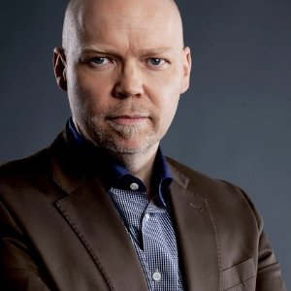
Wolfgang Stindl
Biz Dev Director
eMail: ws@iVentureCapital.com
Cell Europe: +43 – 676 9525 353

Slide 3
Overview
Who We Are
What is “Smart Money” – More Than Just Cash
Types of Funding & Investors – What is Right for You?
How You Find the “Right” Investor
Company Valuation – Myths and Math
Structure of Investments
Overview of VCs, Information Sources
The End – Thank You

Slide 4
Who We Are

Slide 5
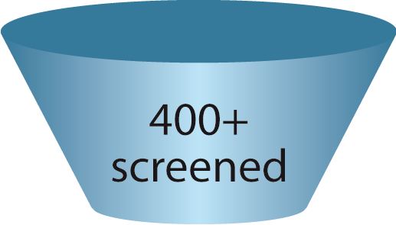


Who We Are – Not a Typical VC
Game companies screened for one & a half years
Funding focused on games industry
Smart Money with entrepreneurial approach
In the e-commerce business for more than a decade
Founders invest their own money only – entrepreneurs by heart ♥
Offices in Hamburg, Germany, Vienna, Austria, Miami, USA

Slide 6





















Our Portfolio
First Exit! : Crobo GmbH
SDK for Sharing, Recording and Traffic Generation

Slide 7
What is “Smart Money” –
More Than Just Cash

Slide 8

“Smart Money” – More Than Just Cash (1)
              Entrepreneurial support - strategic management
              Traffic generation & conversion & discoverability (affiliate, performance campaign optimization, marketing, SEM/ SEO etc.)
              Monetization
                Raising DAUs, MAUs
                Raising ARPU & ARPPU
                Raising Retention
                Pricing optimization (price points, per country, behavioral user targeting)
              Self-Publishing
              Support with in-depth Data Analysis (KPIs)
              Billing and payment knowledge

Slide 9
“Smart Money” – More Than Just Cash (2)
              Synergies and active exchange between the portfolio companies – in our iPoT Workshops
              User support experience
              International network (USA, EU)
              Marketing (present at around 80% of all games events)
              Backoffice (office space in Hamburg, accountants, IT-infrastructure, HR, marketing…)
              Development know how pool (PHP, Java, C, C++, Zend, jquery, jboss, Java Script, JSON, Python, Actionscript 3, Scrum master and teams)
              14 highly qualified system administrators (managing 400+ servers, 100+ mio unique users/month)

Slide 10
Types of Funding & Investors – What is Right for You?
Financing – Sources of Money

Slide 11
Types of Funding…
 | Project oriented | Loans | Equity based
Revenue Share | x
Crowd Funding | x |  | x
Government Funding Programs | (x) | x | x
Convertible Bonds |  | x | x
Bank |  | x
Friends & Family |  | x | x
Financial Investment |  |  | x
Smart Money |  |  | x

Slide 12
…and Types of Investors – What is Right for You?
Seed Stage
Bootstrapping
Early Stage (Prototype/ Beta Program)
Private Equity
Series A/ Series B
Micro VCs
Traditional VCs
Institutional VCs
Bridge/ Mezzanine
Traditional VCs
IPO
Institutional VCs
Friends & Family
Incubators & Accelerators
Bus. Angels
Crowd Funding
Super Angels
VCs
Crowd Funding
Government Funding
Institutional VCs
(preparation for IPO)
SMART MONEY

Slide 13
How to Find the “Right” Investor

Slide 14

How to Find the “Right” Investor
An investor is looking for …
  Team (people & team-spirit), commitment and skills
  Idea & business model
  Something that promises to make money!
How to impress an investor
  Highly qualified and committed team
  Track record
  Cool prototype
  First achievements (KPIs, user base, fans etc.)
  Clear reporting
  Realistic project plan and milestones (achieved & planned)
  List of potential investors at end of presentation

Slide 15

Check the Goals of “Your” Investor
VC
Finding Mr./Ms. Right … almost like dating
Long-term vs. short-term
Dividends or Exit?
  Strategic investor – same goals as yours?
    Synergies/ knowledge transfer
    Cooperation
    Portfolio: synergies and know how exchange
  Financial investor – exit likely in 3-5 years
  IPO or M&A oriented
  Acqu-hire
What do you expect?
Don’t just look for the quick cash but for the long term vision
You are not looking for a quicky but rather a marriage
Just Invested

Slide 16
Company Valuation –
Myths and Math

Slide 17
How Much is a Company Worth?
Business Plan is a First Start, but...
Business Plan
1 Year = Guess
2 Years = Huge Guess
3 Years = Massive Guess
4 Years = Wishful Thinking

Slide 18
How Much is a Company Worth?
Business Plan is a First Start, but...
Business Plan
1 Year = Guess
“I personally don’t believe much in
long term business plans – other investors do!”
2 Years = Huge Guess
3 Years = Massive Guess
4 Years = Wishful Thinking

Slide 19
More Important is…
High quality execution and meeting goals
Focus: Finish one game successfully first, then further games
Business plan vs. project plan (crystal ball vs. vision)
“Right” amount of funding
Be realistic about valuation
Know your product and live it
Total commitment (stay next 3-5 years with the company)
“24/7” responses
Be “on fire”
Good chemistry between investor and your team
The investor wants results – do not be surprised by this

Slide 20

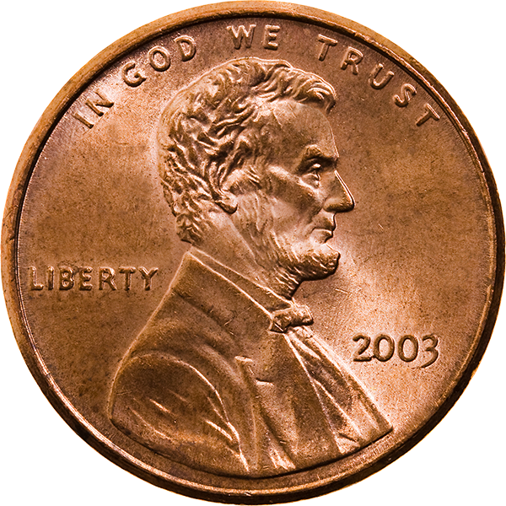
How Much is a Company Worth?
Wishful Thinking…
Founders
Investors

Slide 21

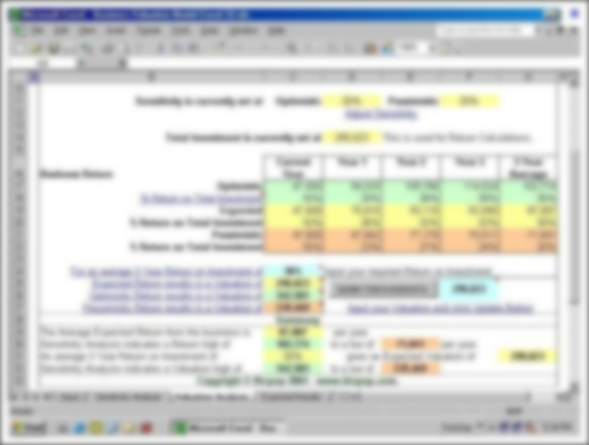
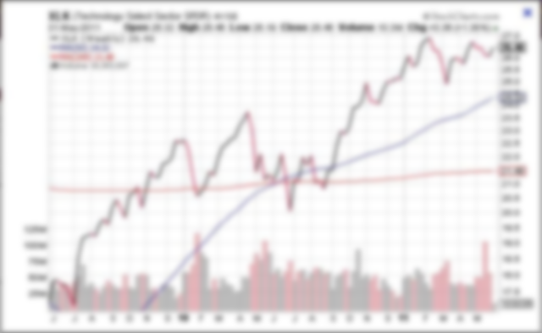
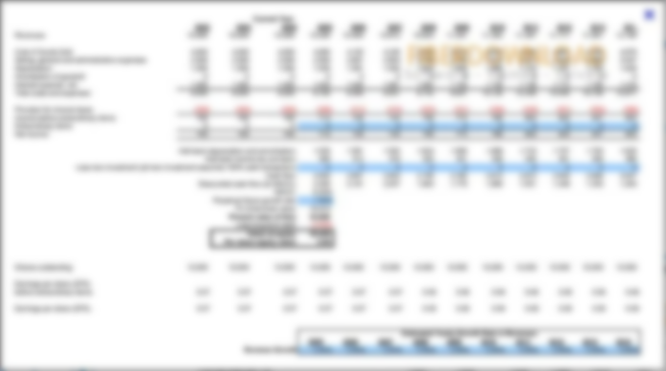
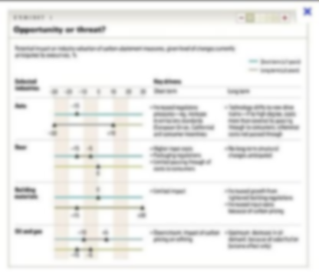
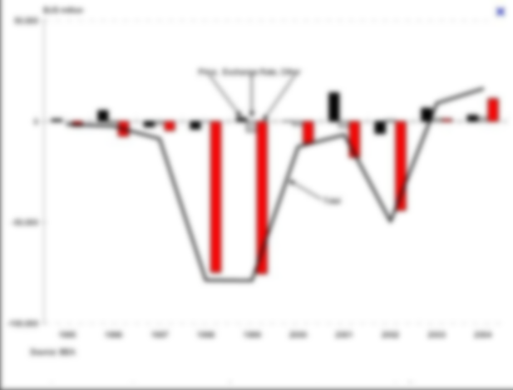
How Much is a Company Worth?

Slide 22





How much is a company worth?
Stock Exchange

Slide 23
Known Models of Other Investors*
YCombinator: 20K for about 2-10% + 3
months in Bay Area
HTGF: €500K for 15% nominal share of the company plus subordinated convertible loan
HackFwd: 1 year salary for 27% (not active anymore)
Gamefounders: 5k per person (usually 2-3 team members) + benefits via industry partners like free hosting; Gamefounders is clearly seed-phase orientated

Slide 24
Another Approach…
How much money do you need?
How much equity are you willing to give away?
Money required
Share at Disposal
= Valuation
So that is the value of your company?

Slide 25
Another Approach…
NO!
How much money do you need?
How much equity are you willing to give away?
Money required
Share at Disposal
= Valuation
So that is the value of your company?

Slide 26

Honest answer: Nobody knows!
There are a trillion methods to calculate the value!

Slide 27
How Does iVentureCapital Evaluate?
Rather dividend- than exit-oriented, therefore
  Time to market
  Time to revenue
  Time to PROFIT
Based on the prospected PROFIT of the next 1-3 years
  Profit can stay in the company for growth
Cash & “Smart Money”
  Our resources and time - people, advise, network, etc.
  - which will not be billed by us - must be “worth it for the shares we get”

Slide 28
Structure of Investments

Slide 29
Amount and Structure of Investment
Funding should bring company
  To break-even/ positive cash-flow
  Significant successes and high performance KPIs
Cash installments will be paid out when Milestones are fulfilled
Installments: distinguish funds required for
  Development and
  Marketing separately

Slide 30


Nothing is set in stone!

Slide 31
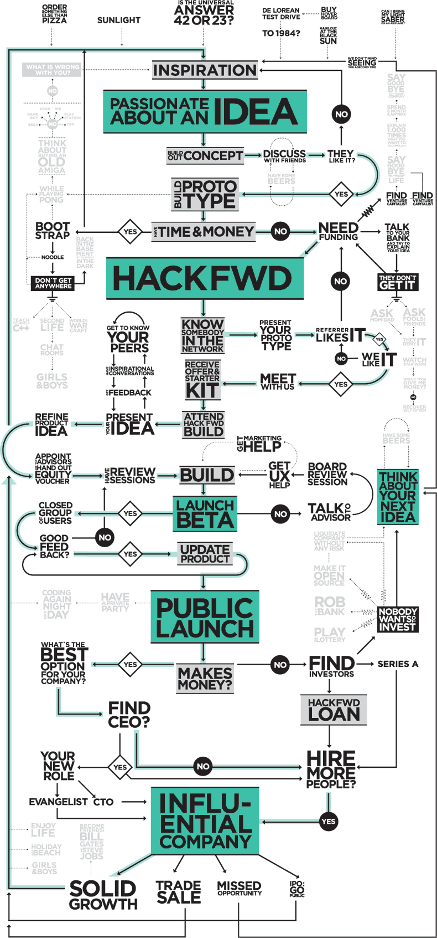
Timing – How Long Does It Take?
1- 12 months (or more ☺)
Initial contact – elevator pitch
Presentation of company & product – executive summary
VC templates & business plan
First evaluation
Financial data (P&L, forecast, KPIs etc.)
Personal meetings
Negotiations
Term sheet
Due diligence
Final negotiation
Contract & notary
=> Transfer of funds & active support where needed
http://hackfwd.com

Slide 32
Overview of VCs &
Information Sources

Slide 33
Overview of VCs & Information Sources
HackFwd: http://hackfwd.com
Hanse Ventures: http://www.hanse-ventures.de
ShortCut Ventures: http://shortcut.vc
CatCap: http://www.catcap.de
Neuhaus Partners: http://www.neuhauspartners.com/
Target Partners: http://www.targetpartners.de
Paua Ventures: http://www.pauaventures.com
Team Europe Ventures: www.teameurope.net
Project A Ventures Gmbh: http://www.project-a.com
Bergfürst: https://de.bergfuerst.com
Companisto: https://www.companisto.de
Ycombinator: http://ycombinator.com
HTGF: http://www.high-tech-gruenderfonds.de
Innovationsstarter Hamburg GmbH: www.innovationsstarter.com
IBB: http://www.ibb.de
Insight Partners: http://www.insightpartners.com
DN Capital: http://www.dncapital.com
Parklane Capital: http://www.parklane-capital.de
eventurecat: http://www.eventurecat.com
GP Bullhound: http://gpbullhound.com
Corporate Finance Partners : http://www.cfpartners.com
Seahorn Capital Group: http://www.seahorn.net
Tech Cost Angels: http://www.techcoastangels.com
Siemer & Associates LLC: http://www.siemer.com
Detonate Ventures: http://d2n8.com
Avista Capital Group: http://www.avistacap.com
Interesting Links:
http://venturebeat.com
http://www.inc.com/start-up
http://techcrunch.com
http://mashable.com
http://www.gruenderszene.de
http://www.deutsche-startups.de

Slide 34
Synergies of the iVentureCaptial network

Slide 35

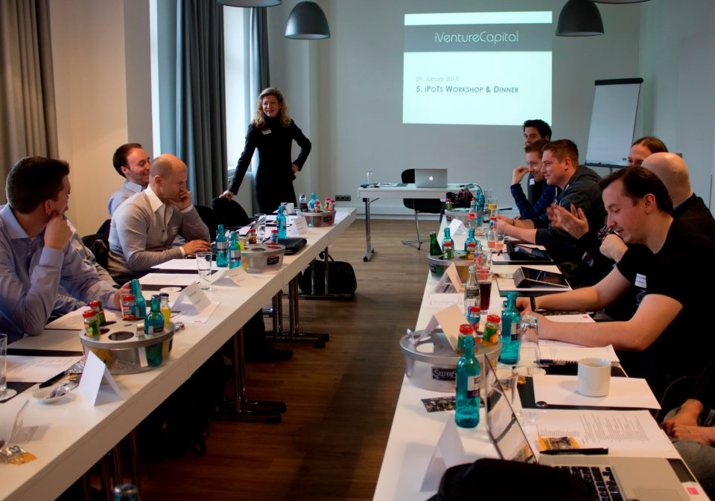
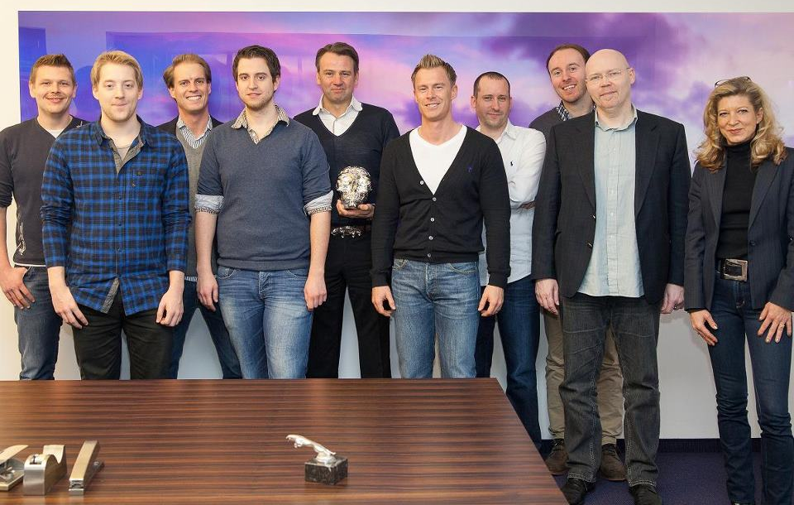
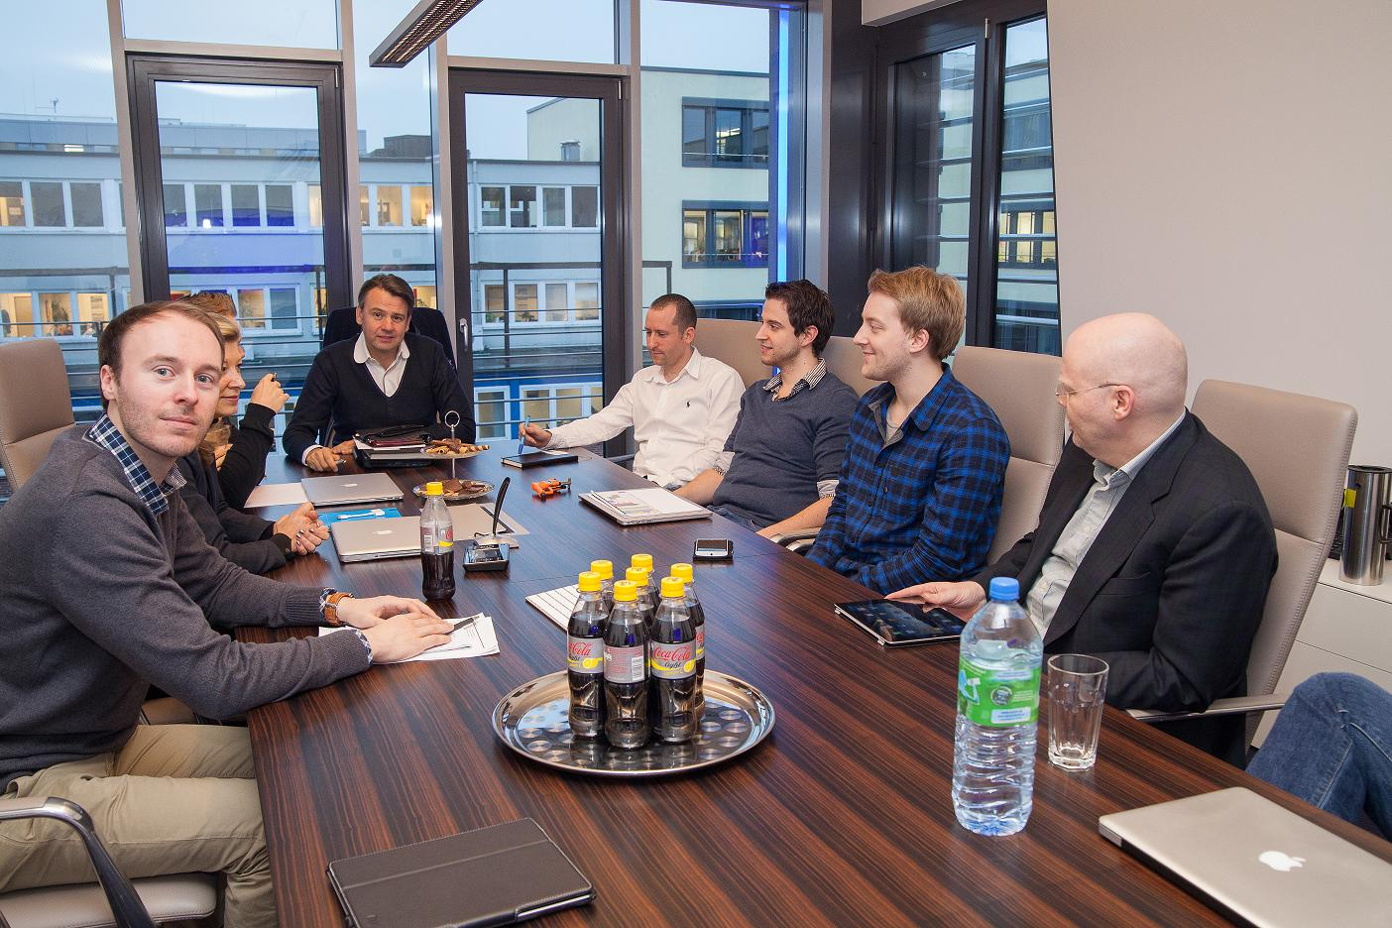
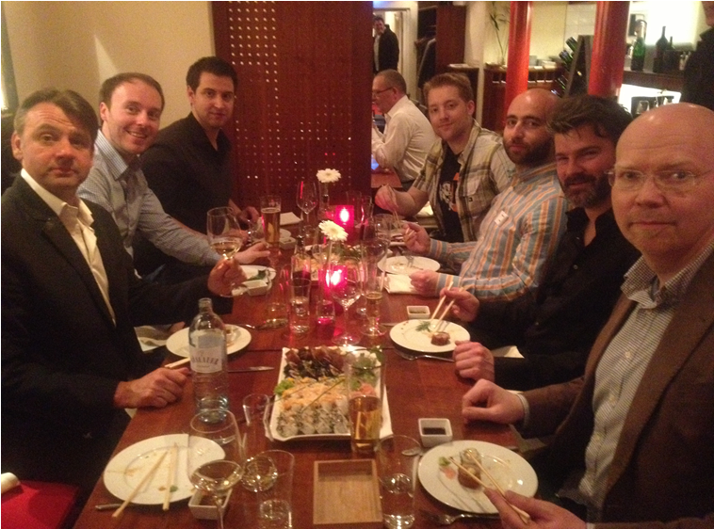

Slide 36
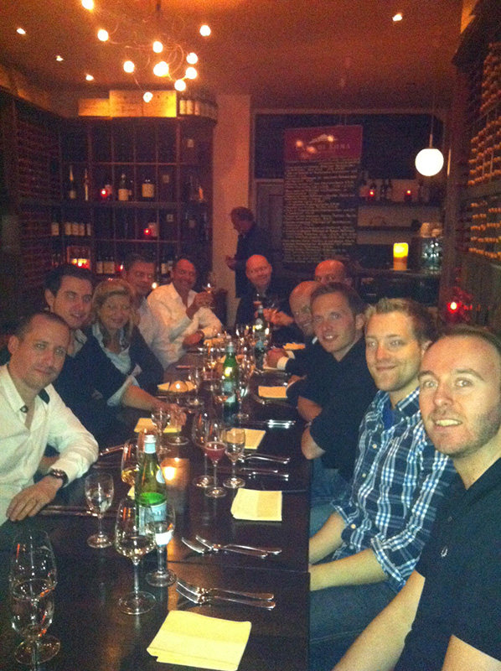






Synergies of the iVentureCapital Network
Investment of personal resources and coaching where needed
Low cost traffic generation & conversion optimization – TrafficCaptain.com, Games.de, allvatar.com, Kamcord.com
Monetization & Analytics
Infrastructure
Synergies & experience exchange within the portfolio – iPoT workshops

Slide 37










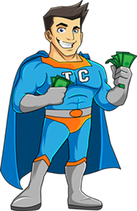

Support + Consulting:
Monetization
Business Development
Publishing
Marketing + PR
Analytics + KPIs
Monetization
Analytics
Feedback
Survey+Feedback for new game control (Fun Maximizer Campaign)
Gamer’s Journal
Traffic for SFD
Two-Way Support
Human Resources
Office Space
Exklusive Content
Two-Way Feedback
Traffic for SFD
Game Design Concepts
Monetization Concepts
Exclusive Crystals for games.de User
Beta-Key Campaign
Exchange of Experience
Monetization
KPIs
Client Technologies
Server Technologies
High Quality Traffic Purchase
Exclusivity
Notes:
Sind „HR“ Human Resources

Slide 38


And now the Work (& Fun) Begins!
Yipeehhh!

Slide 39
Conclusions
Make sure that your company is in sync with market development
Make sure that the objectives are realistic and obtainable
Be senior ;-)
Above all, make sure the motivation of the team is supreme!

Slide 40
Thank You!

